Slide 1
Hamiltonian simulation theory and application in simulating coupled classical oscillators
Edson Vasquez

Slide 2
Hamiltonian Simulation
Defining the problem
In this project we will implement Hamiltonian simulation with three different techniques: Product formulas (Suzuki - Trotter), Quantum Singular Eigenvalues ​​Transform (QSVT) and Qubitization, a brief theoretical foundation on product formulas, block encoding and Linear Combination of Unitaries (LCU) for the Hamiltonian first in a toy problem and then in the specific case estimated to simulate coupled classical oscillators
H= hamiltonian
t= time ====> exp(-iHt) is unitary matrix so we can implement it on quantum computer

Slide 3
Because?=
Hamiltonian simulation (also referred to as quantum simulation) is a problem in quantum information science that attempts to find the computational complexity and quantum algorithms needed for simulating quantum systems. Hamiltonian simulation is a problem that demands algorithms which implement the evolution of a quantum state efficiently. The Hamiltonian simulation problem was proposed by Richard Feynman in 1982, where he proposed a quantum computer as a possible solution since the simulation of general Hamiltonians seem to grow exponentially with respect to the system size.

Slide 4
Methods implemented for hamiltonian simulation
Product Formulas (Suzuki - Troter)
Qubitization
Quantum Singular Eigenvalues ​​Transform (QSVT

Slide 5
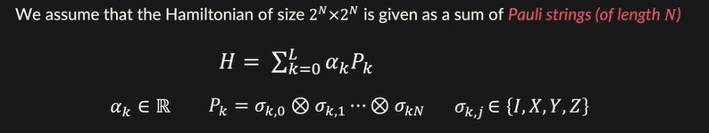
Product Formulas
A set of formulas for approximated hamiltonian simulation, each formula is characterized by order(o) and number of repetitions (r)
Suzuki - Troter function
Classiq provides an optimized implementation, reducing CX - counts and function depth.
The function produces the Suzuki-Trotter product for a given order and repetitions.

Slide 6
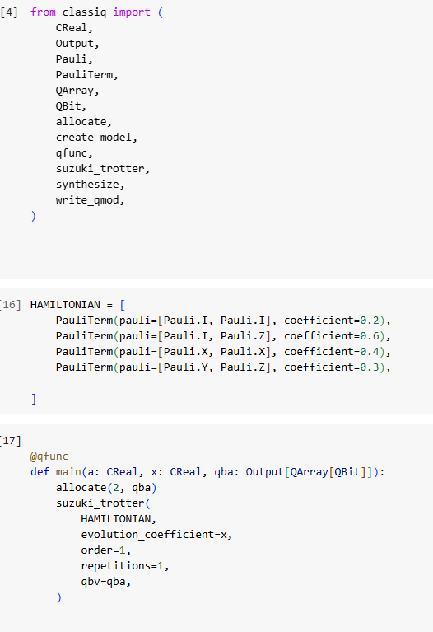
Our Toy Problem
exp(-iHt)=

Slide 7
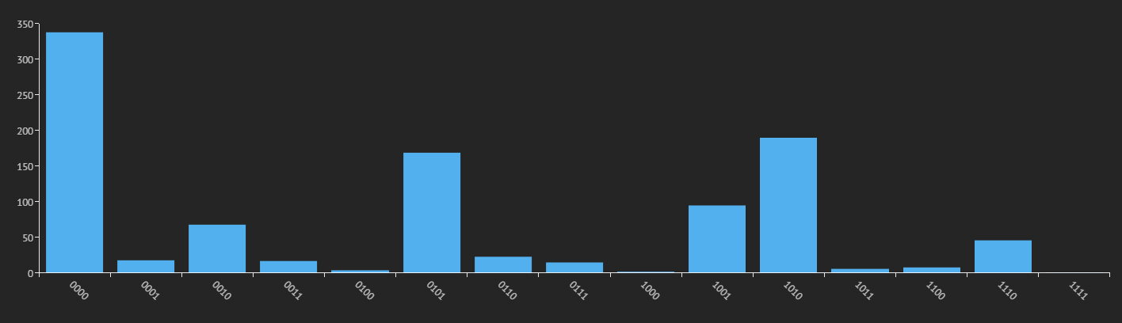
Execute graphics on classiq cloud using Product Formulas

Slide 8
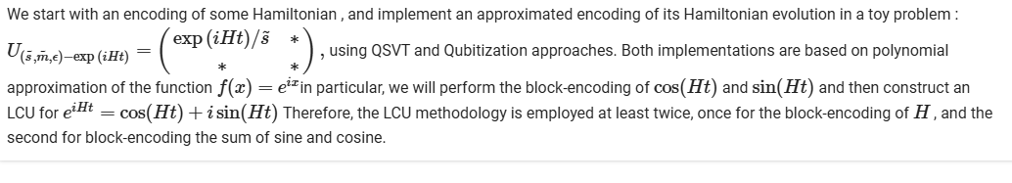
Block - encoding based aproximations
Quantum Singular Eigenvalues ​​Transform (QSVT) and Qubitization

Slide 9
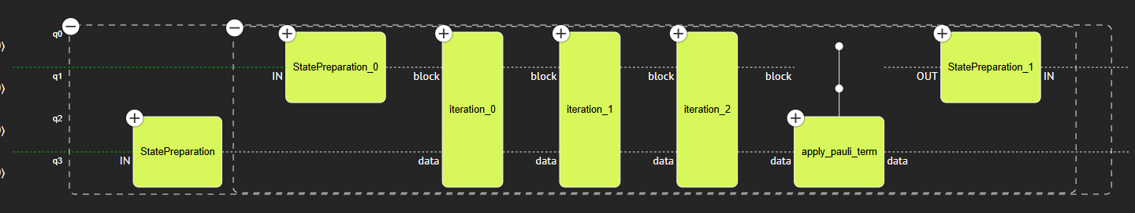
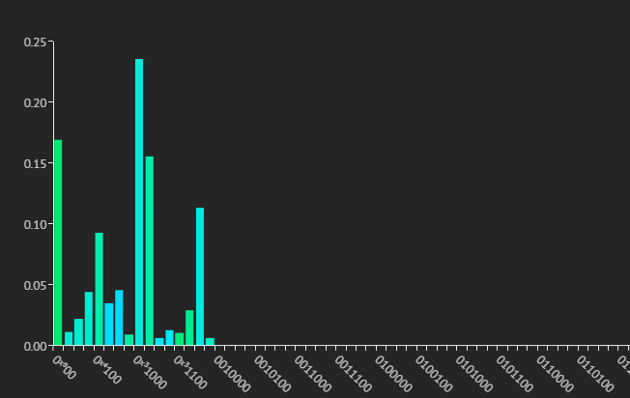
Hamiltonian Simulation with Qubitization
Execute graphics on classiq cloud using Quibitization

Slide 10
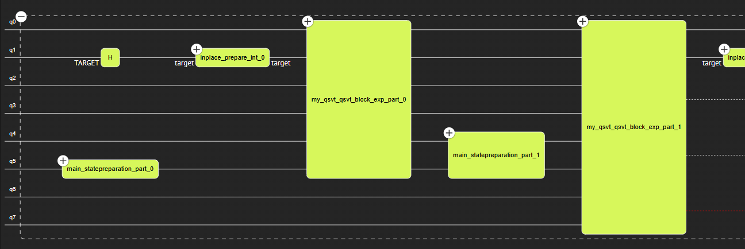
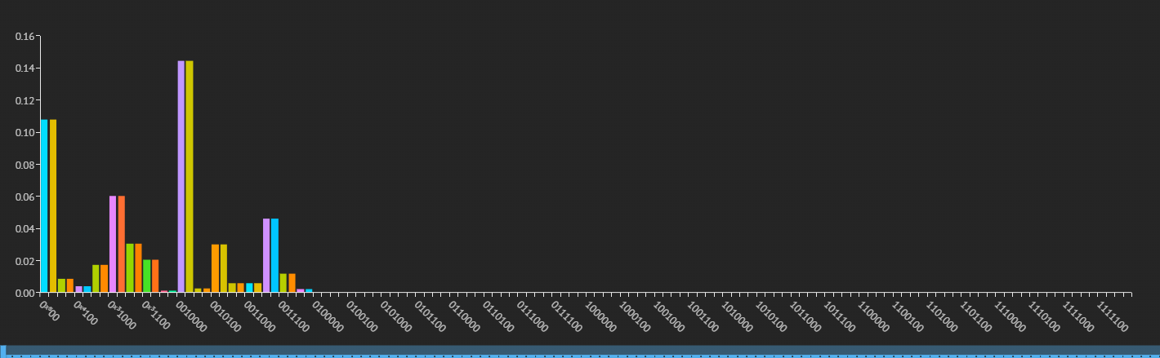
Hamiltonian Simulation with QSVT

Slide 11
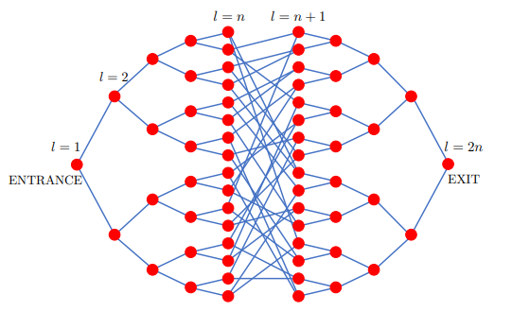
Coupled classical oscillators
Consider a network of N = 2n+1 − 2 masses coupled by springs, where M=1 and K coincides with the adjacency matrix of a graph consisting of two balanced binary trees of depth n “glued” randomly as in Figure (i.e., the spring constants are κjk=1 if (j, k) is an edge of the graph or κjk = 0 otherwise). Each mass (vertex) of the network is labeled randomly with a bit string of size 2n . The network contains two special and verifiable masses, ENTRANCE and EXIT, which correspond to the roots of both trees. Given oracle access to K and the label of the ENTRANCE mass, the problem is to find the label of the EXIT mass.

Slide 12
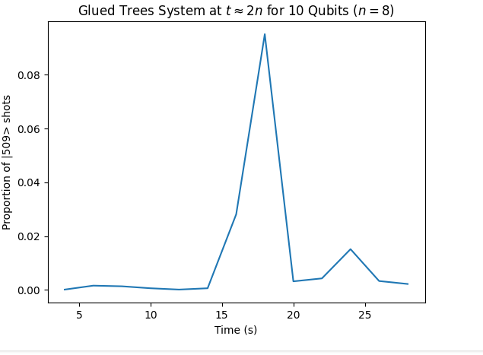
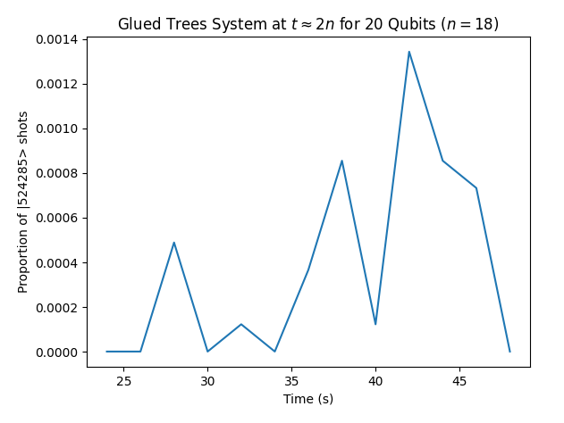
SUZUKI TROTER APROXIMATION FOR COUPLED CLASSICAL OSCILLATORS

Slide 13
QUBITIZATION APROXIMATION FOR COUPLED CLASSICAL OSCILLATORS

Slide 14
QSVT APROXIMATION FOR COUPLED CLASSICAL OSCILLATORS

Slide 15
References
1] Babbush, Ryan and Berry, Dominic W. and Kothari, Robin and Somma, Rolando D. and Wiebe, Nathan. "Exponential Quantum Speedup in Simulating Coupled Classical Oscillators." Phys. Rev. X 13, 041041 (2023)
[2]Andrew M Childs, Richard Cleve, Enrico Deotto, Edward Farhi, Sam Gutmann, and Daniel A Spielman, “Exponential algorithmic speedup by a quantum walk,” in Proceedings of the thirty-fifth annual ACM symposium on Theory of computing (2003) pp. 59–68.
[3]https://docs.quantum.ibm.com/api/qiskit/qiskit.quantum_info.SparsePauliOp
[4] https://en.wikipedia.org/wiki/Operator_norm

